Slide 1

NU EVENTS
Varsha Reddy Kumbham - 002762752
Devika Boddu - 002727628
Sindhura Bandaru -002727624
Sahithi Gaddam- 002766983

Slide 2
Purpose
As an University Student, it is difficult to gather information about events from various social media websites such as Facebook, Instagram, WhatsApp etc.
To overcome this problem, we developed a handy website that aggregates all university activities and displays them on a single dashboard for the user's convenience.

Slide 3
FeATUReS
Login and SignUp Functionality.
Welcome email Notification to the Registered Users.
CRUD Operations on the Events.
Search Functionality on the different events
View Event Details
Bookmark/Un bookmark the interested events
Register for an Event
Google Maps functionality under My Events for navigating to a event location.
Online Sharing of an Event via Facebook, LinkedIn and Twitter.
View the Registered events Schedule under Calendar.
Unregister for a registered event
Notification email to Registered users upon deletion of an event by Admin
Responsive UI Design
User friendly and easy to access

Slide 4
External API’s Implemented
Mongoose, MongoDB database in the cloud (Atlas).
Full Calendar IO API.
Google Maps API

Slide 5
Tech Stack
Node
Express
MongoDB
React
Redux
SASS
Session Storage

Slide 6
Contributions
Varsha Reddy Kumbham - SignUp, Login, Forgot password, Bookmark Events
Devika Boddu – Explore, Blogs, View Event, Email notification
Sindhura Bandaru - Admin, User Profile, Share Events
Sahithi Gaddam – Registered and Unregister Events, Calendar, Maps
Everyone contributed equally to implement frontend and backend of the application

Slide 7
References
https://blog.logrocket.com/redoing-search-ui-with-react-context-and-refs/
https://fullcalendar.io/docs/react
https://maps-generator.com/
https://medium.com/@MichelePicozzi/create-a-share-social-icon-button-for-react-referencing-the-dom-element-f1157ceea373

Slide 8
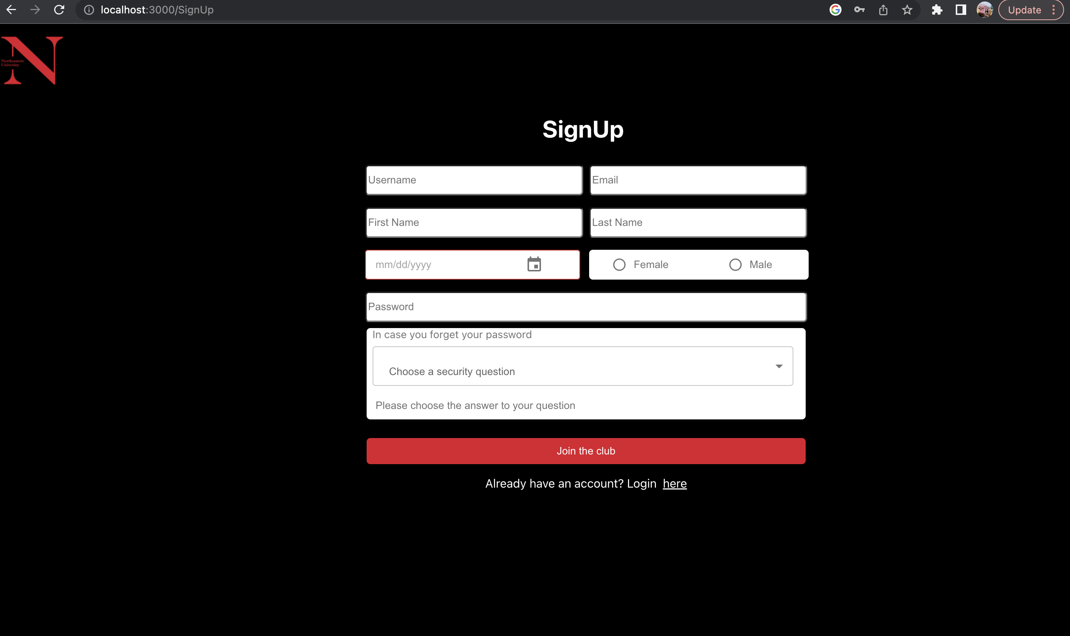
SIGnup screen

Slide 9
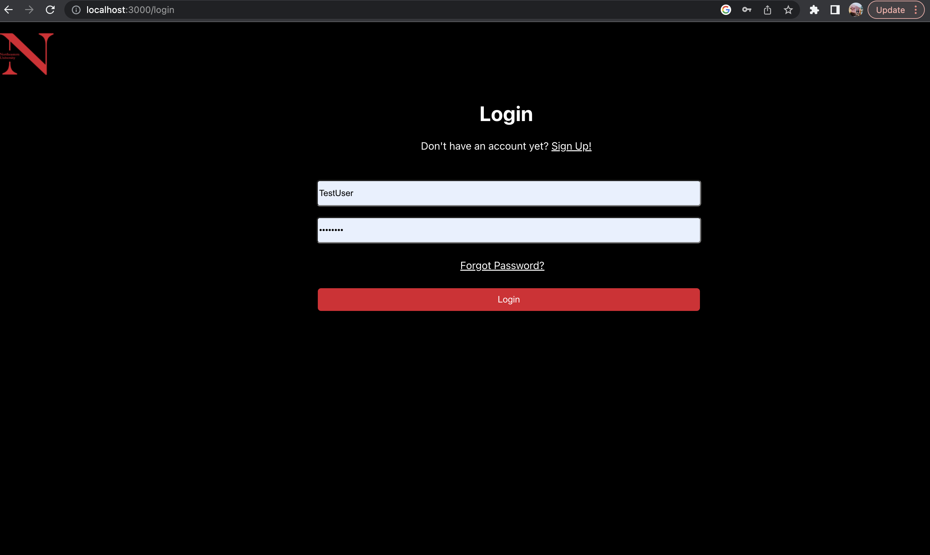
Login screen

Slide 10
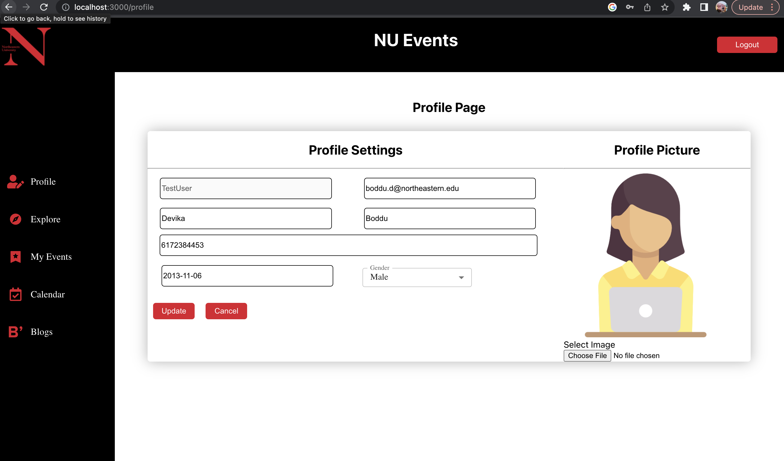
USER PROfile

Slide 11
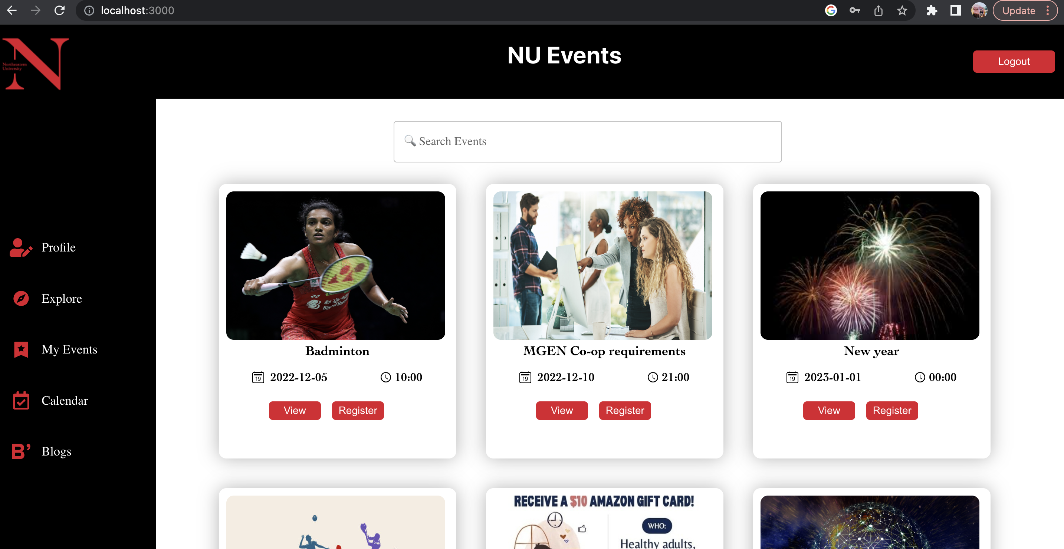
Events dashboard

Slide 12
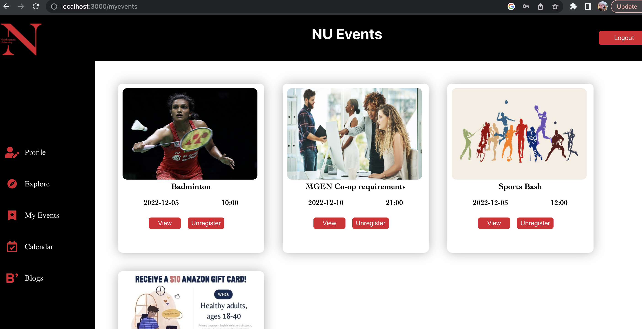
Registered events

Slide 13
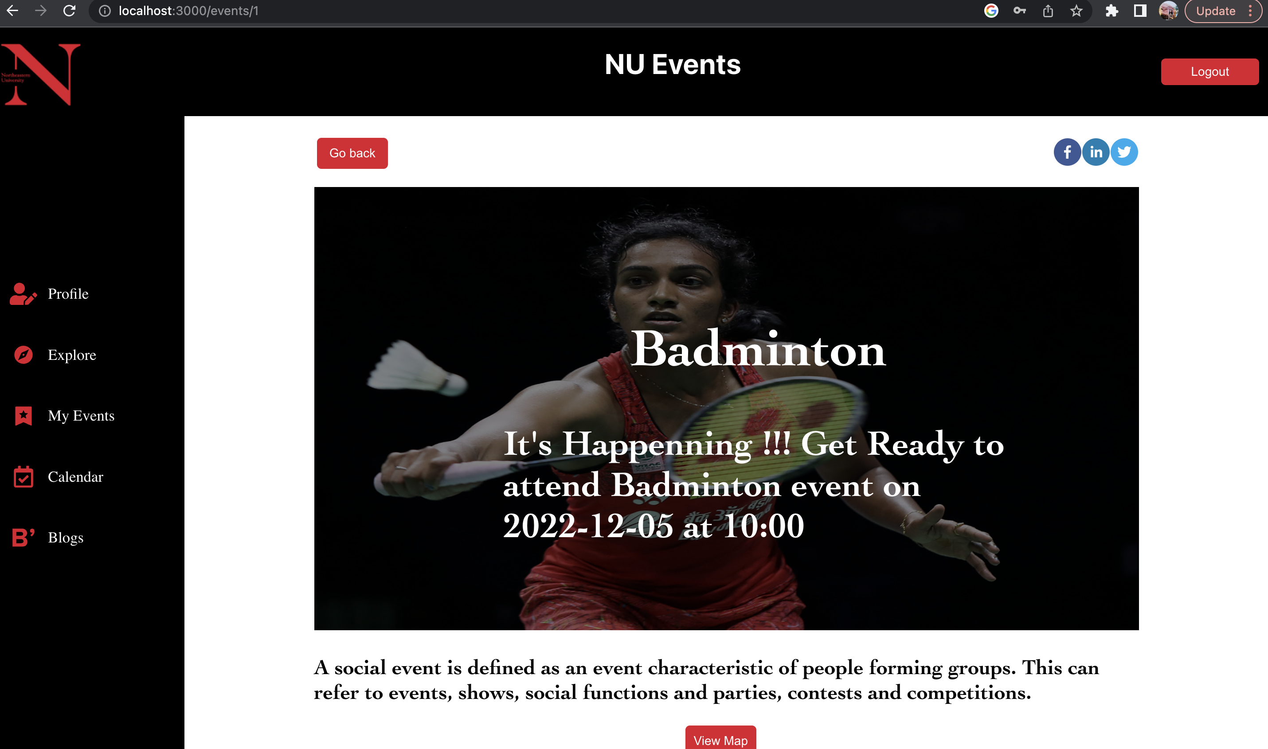
View event

Slide 14
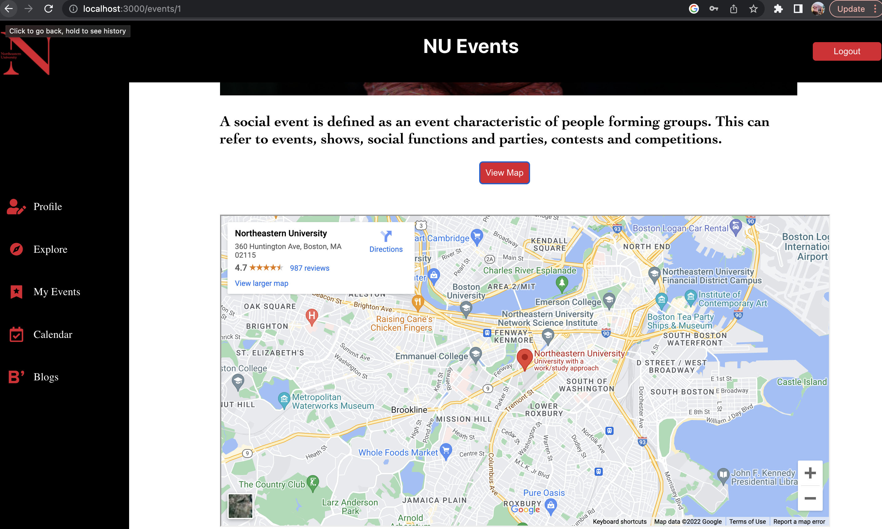
VIEW MAP

Slide 15
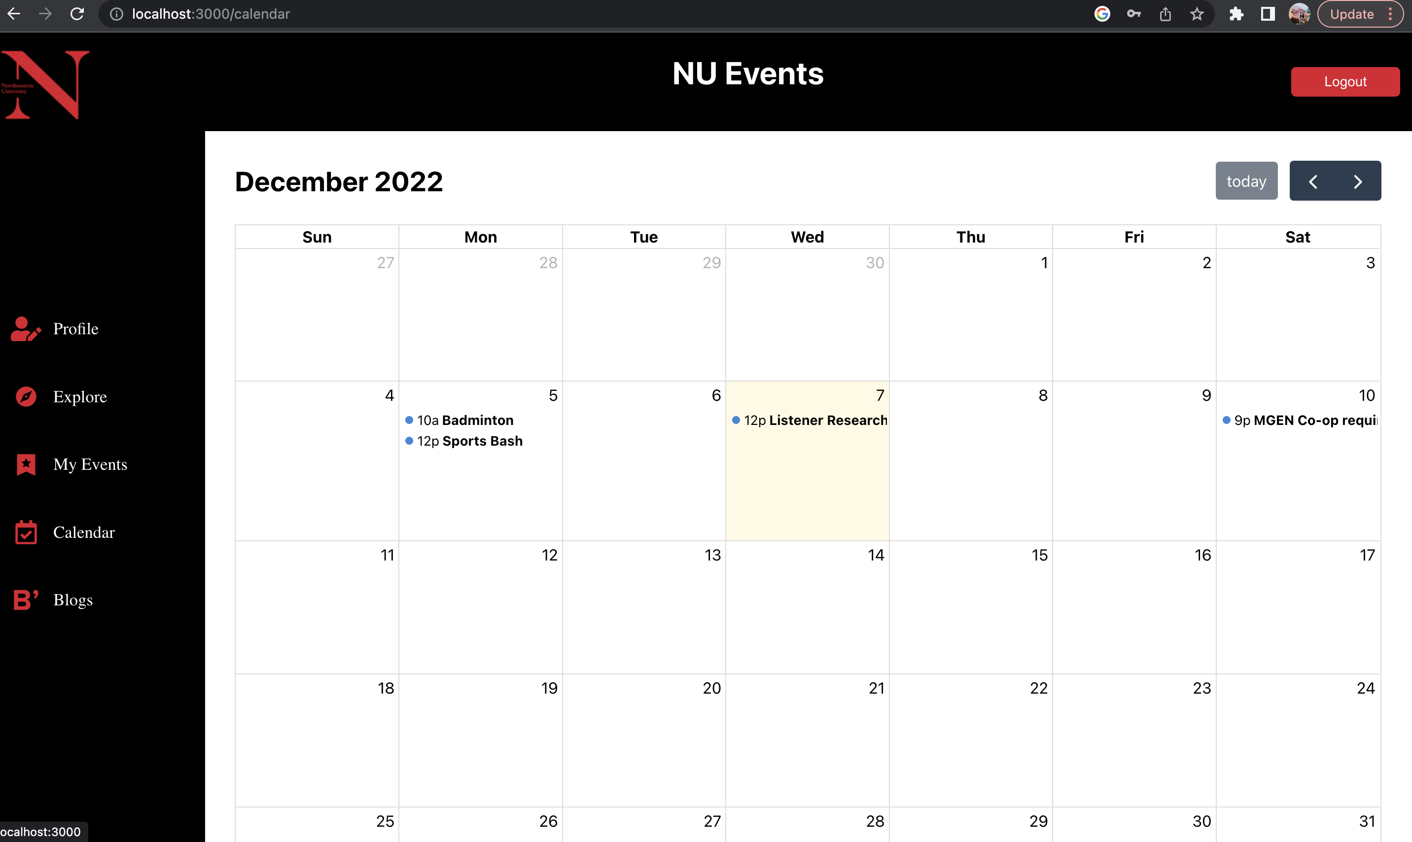
calendar

Slide 16
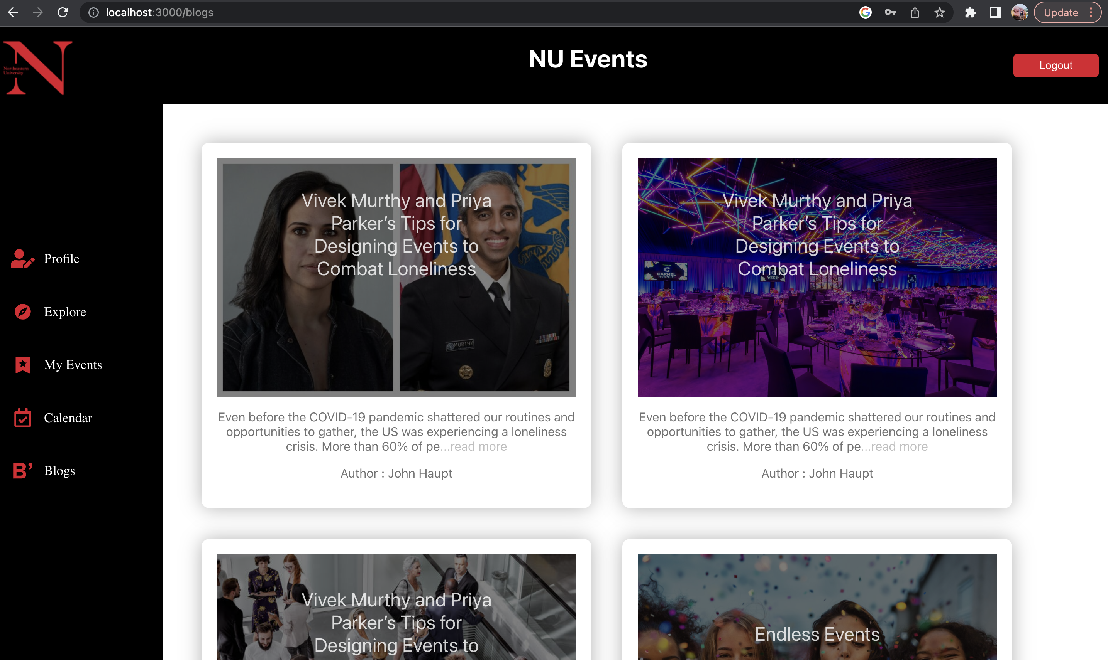
blogs

Slide 17
LOGOUT

Slide 18
THANK YOU

